Slide 1

Monthly Market Mantra
March, 2026
Monthly Market Update February, 2026

Slide 2
Market Overview
India
Q3FY26 GDP growth in at 7.8% (vs 7.2% est.); base year revised to FY23
CPI inflation rose to 2.75% in Jan-26 from 1.2% in Dec -25, price pressures
CAD at 1.3% of GDP (~US$1.3 bn), supported by a stronger services surplus
Other International Market
Eurozone inflation rises to ~1.9% (Feb‑26), keeping ECB cautious on rate cuts
BoJ holds rate at 0.75%, maintaining cautious stance amid inflation and geopolitical risks
China set a lower GDP growth target of 4.5-5% for 2026
U.S.
US PMI rose to 56.1 in Feb-26 from 53.8 in Jan-26
US headline CPI slowed to 2.4% in Jan-26
US labour market stable with unemployment at ~4.3% (Feb-26), indicating gradually cooling job market
International
Gold at ~ $5,170 per ounce amid safe heaven demand
Brent crude touched ~USD 83/bbl but eased later, on escalating Middle East tensions
Global sentiment cautious on commodity rise, mixed data, Middle East tensions
Source: Moneycontrol, Bloomberg, CNBC, Trading economics
As on 5th March 2026
www.shriramamc.in

Slide 3
Indian markets rangebound in Feb-26
Indices were broadly rangebound, Nifty next 50 marginally higher in 1M period
Nifty midcap 50 outperformed in 6M and 1Y period
Disclaimer: Past performance may or may not sustain in the future
Data Source: NiftyIndices.com
Data as on 27th February 2026
www.shriramamc.in

Slide 4
Global Markets (MSCI) – Geopolitical Impact
Indian market were rangebound in 1M period, amid cautious FII flows and profit booking
US market was flat 1M period due to geopolitical tensions and weak macros
Japan market rallied in 1M period on pro-growth policy expectations & expansionary fiscal measures
Disclaimer: Past performance may or may not sustain in the future
Data Source: MSCI.com
As on 27th February 2026
www.shriramamc.in

Slide 5
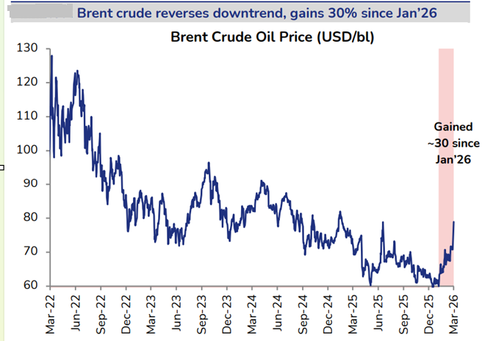
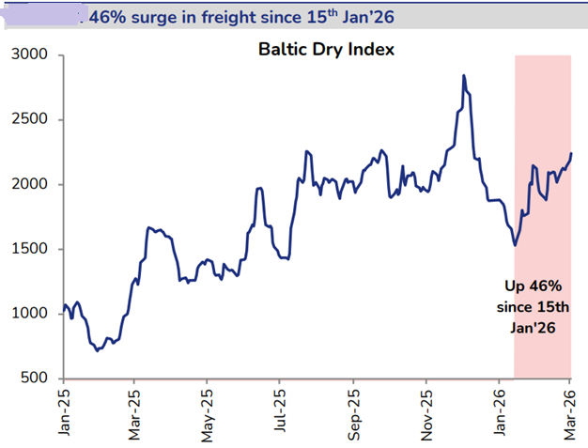
Crude & Freight prices surge ahead of Middle East conflict
Brent Crude oil up +30% since Jan-26
Freight cost surged by 46% since mid Jan-26
Source: JM Financials research
Brent Crude, freight data as on 5th March,2026
www.shriramamc.in

Slide 6
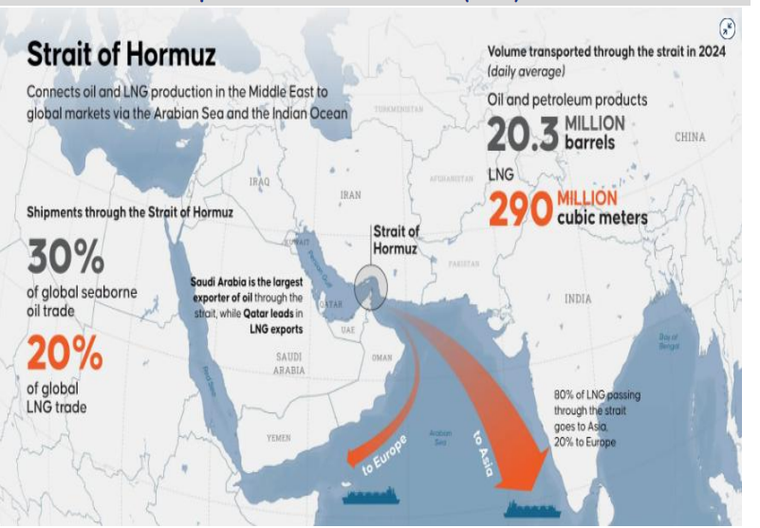
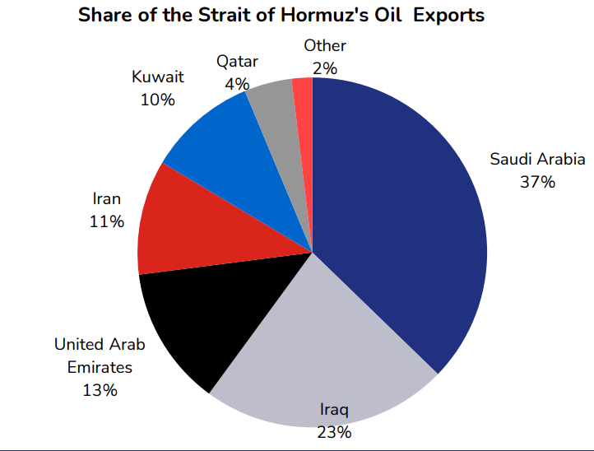
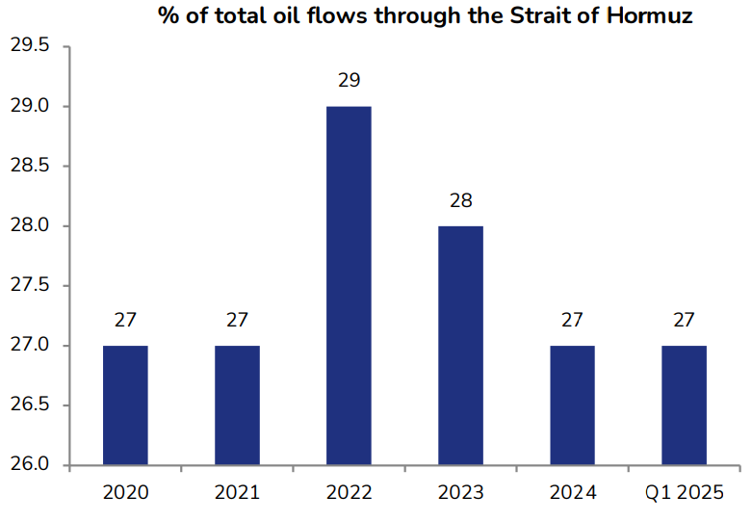
Strait of Hormuz – Strategic oil route
SOH is the key oil route for global oil & LNG exports
27% of total global oil demand flows through Strait of Hormuz
Source: JM Financials research
www.shriramamc.in

Slide 7
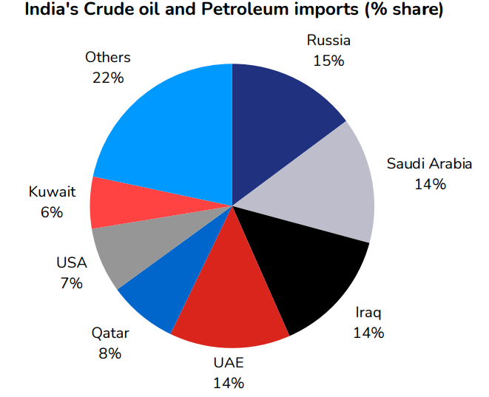
India’s crude oil supply
India’s crude oil imports from Russia fell to ~$1.98 bn in Jan‑26, down to ~15% of total imports from 33% in May‑25
Middle East accounts for over 55% of India’s oil imports, post US sanctions on Russia
Source: JM Financials research
www.shriramamc.in

Slide 8
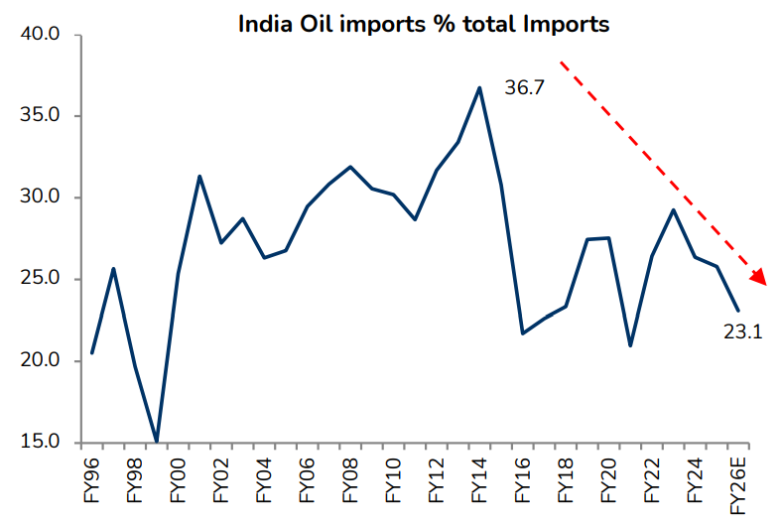
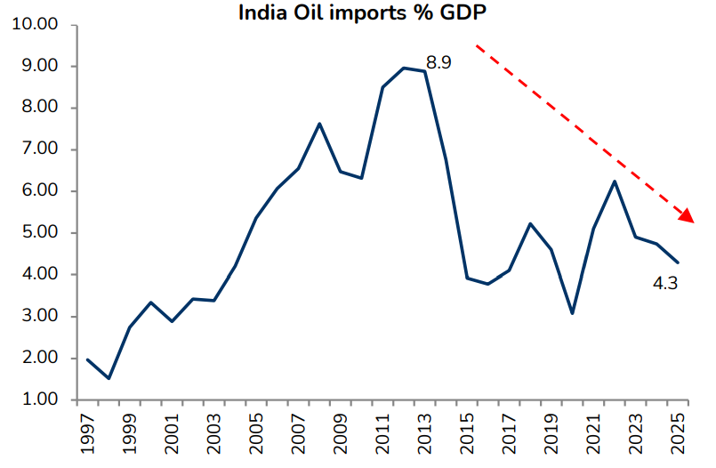
India has reduced oil import dependence
India’s oil share in total imports has dropped from 36.7% in FY14 to 23.1% in FY26
India’s oil imports % of GDP has dropped from 8.9% to 4.3% as on FY25
Source: JM Financials research
www.shriramamc.in

Slide 9
Sector Indices performance – Feb-26
Period | Nifty Auto | Nifty Bank | Nifty Consumer Durables | Nifty CPSE | Nifty FMCG | Nifty Pharma | Nifty IT | Nifty Metal | Nifty Oil & Gas | Nifty Realty | Nifty Energy | Nifty Commodities
1M | 5% | 2% | 9% | 4% | 0% | 6% | -20% | 3% | 4% | 0% | 5% | 3%
3M | 1% | 2% | -1% | 11% | 8% | 0% | -18% | 19% | 2% | -14% | 4% | 8%
6M | 13% | 14% | -3% | 15% | -9% | 5% | -13% | 34% | 14% | -10% | 10% | 16%
1Y | 37% | 27% | 9% | 32% | 1% | 16% | -18% | 49% | 28% | -2% | 23% | 31%
Top Performer : Nifty Consumer Durables, Pharma, Energy & Auto
Top Laggard: Nifty IT
Data Source: NiftyIndices.com
Data as on 27th February,2026
Disclaimer: Past performance may or may not sustain in the future
www.shriramamc.in

Slide 10
Sectors update
Sectors | Key Developments | Valuation | Our View
Consumer Durables | C&W prices up ~25% since Dec’25 amid rising copper & aluminum costs; RACs to see 4–9% hikes with 2026-compliant products. Hikes support margins and 4QFY26 value growth, partly offset GST cuts, though high channel inventory may limit incremental demand. Further price increases possible if commodity costs continue rising | Trailing P/BV near +1SD | Underweight
Oil & Gas | Brent crude has risen to $100+/bbl (highest since mid-2024) amid Middle East tensions and Strait of Hormuz risks, while European gas prices (Dutch TTF) have surged ~45% to ~€46/MWh due to disruptions in Qatari LNG supply (~20% of global exports). Positive for oil exploration companies, while OMCs face margin pressure | Trailing P/BV just above 5-yr average | Stock Specific
Auto | February 2026 retail data showed broad-based double-digit growth across 2Ws, PVs, CVs and tractors. The India–US trade deal, which reduced tariffs from 25% to 18%, meaningfully eases the overhang on auto ancillary exporters, particularly those supplying US CV segments. EV penetration continues to rise with 2W EVs gaining share steadily | Trailing P/BV trading near 1 SD | Stock specific bottom up
FMCG | FMCG demand gradually recovers with improving rural trends and steady urban consumption. Margins stable but rising crude may increase costs; high competition limits pricing power. Rainfall in 2026 will be key for rural income and overall consumption momentum | Trailing P/BV just below 5-yr average SD | Stock specific
Disclaimer: Sectors specific views mentioned herein are for Information purpose only, the Fund may or may not hold any present or future positions in these sectors
www.shriramamc.in

Slide 11
Sectors update
Sectors | Key Developments | Valuation | Our View
Banks | Bank credit growth at 14.6% YoY (Jan‑26) with deposits at 12.5%; system liquidity comfortable, repo steady at 5.25%. SEBI overhauled broker norms after 30 years; Bihar Microfinance Bill poses near-term headwinds. Financial services remain constructive on strong credit momentum, low NPAs, improving NIMs, and supportive macro heading into FY27 | Trailing P/BV near –1 SD | Overweight
Metals | Steel sector saw volume growth supported by infrastructure and auto demand; spreads resilient from operational efficiencies and recent price hikes. Non-ferrous companies posted strong earnings on higher commodity prices and stable volumes, while mining faced volume and cost pressures. Near-term earnings will depend on realizations, raw material costs, and domestic demand momentum | Trailing P/BV ~ 5-yr >+2× SD | Stock specific
CPSE | Capital goods & defence posted strong YoY profit growth in Q3FY26 on robust orders; major contracts (~INR 5,083 cr) for helicopters & missiles and EU‑India defence cooperation supports long term sector visibility | Trailing P/BV ~ 5-yr near +1× SD | Stock specific
Disclaimer: Sectors specific views mentioned herein are for Information purpose only, the Fund may or may not hold any present or future positions in these sectors
www.shriramamc.in

Slide 12
Sectors update
Sectors | Key Developments | ValuationFY25 | Our View
IT | Indian IT majors are actively partnering with leading AI platforms, repositioning themselves as AI led transformation partners. The sector has seen a sharp valuation correction driven by AI disruption fears, which we believe is an overreaction to medium term structural concerns. We continue to stay invested given strong deal pipelines and an improving demand outlook | Trailing P/BV below -2 SD | Stock Specific
Pharma | Healthcare remains defensive with non-discretionary demand, offering earnings visibility. Domestically, branded formulations gain on chronic therapy momentum, with GLP-1 launches as a near-term catalyst. US generics face pricing pressure and intense competition, limiting margin expansion. Sector remains constructively positioned | Trailing P/BV near +1 SD | Stock specific
Chemicals | Chemical sector under pressure with FY26 EPS cuts up to 67% amid weak demand, inventory destocking, and global oversupply from China. Margins broadly contracted, few resilient. Near-term outlook bearish with overcapacity and sluggish global demand | Trailing P/BV fairly valued | Stock specific
Disclaimer: Sectors specific views mentioned herein are for Information purpose only, the Fund may or may not hold any present or future positions in these sectors
www.shriramamc.in

Slide 13
FIIs flows turn positive in Feb-26
DIIs buying moderated while FIIs turned buyers
Source: Moneycontrol.com
FII &DII data as on 27th Feb-26
www.shriramamc.in

Slide 14
Global Update
www.shriramamc.in

Slide 15
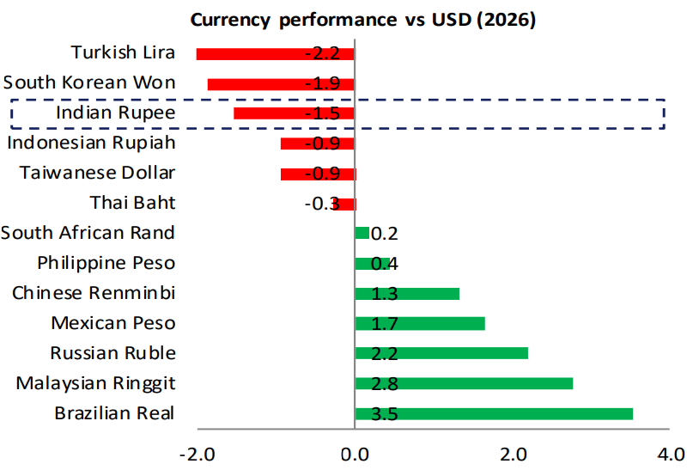
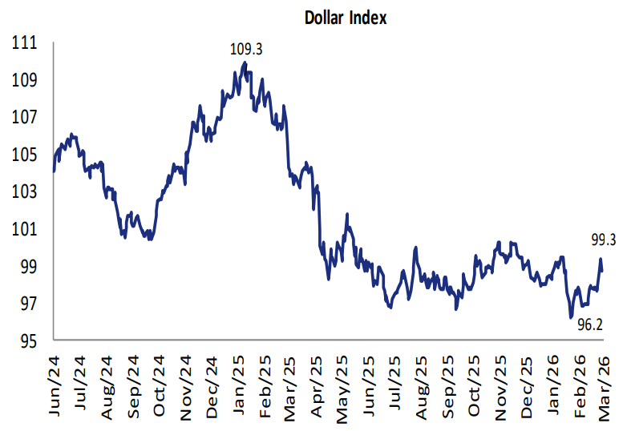
INR depreciates CYTD & DXY surges
INR has depreciated by ~1.5% CYTD against global currencies
Dollar Index has gained since Feb-26
Source: JM Financials research
INR & DXY data as on 5th March, 2026
www.shriramamc.in

Slide 16
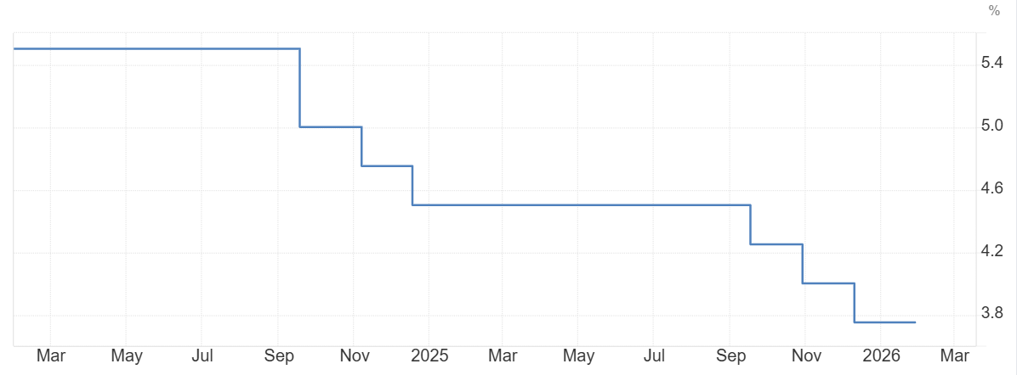
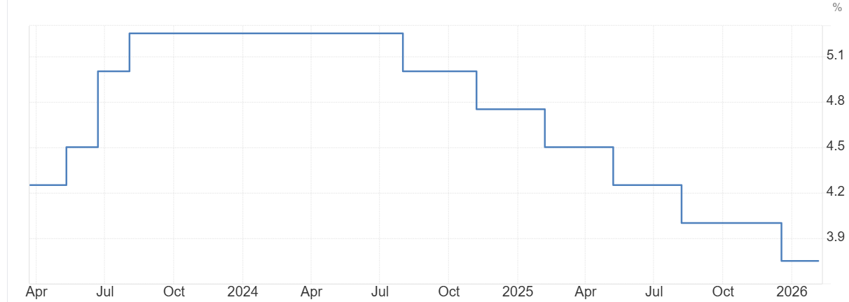
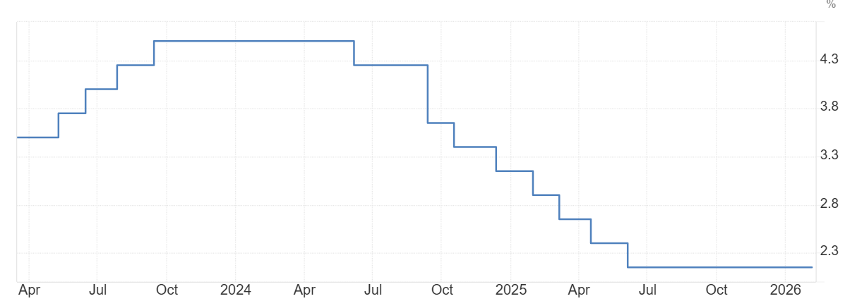
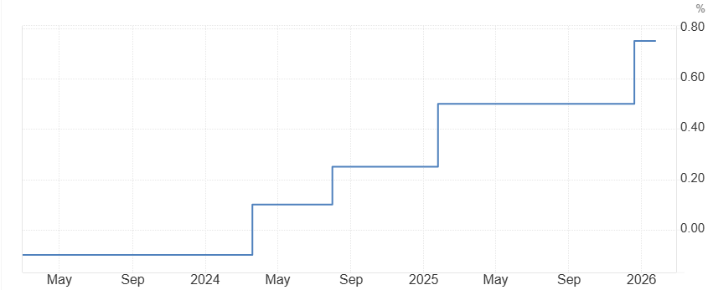
Global interest rate
U.S. (unchanged in Jan-26)
UK (unchanged in Feb-26)
EU (unchanged in Jan-26)
Japan (unchanged in Jan-26)
Source: Trading Economics
www.shriramamc.in

Slide 17
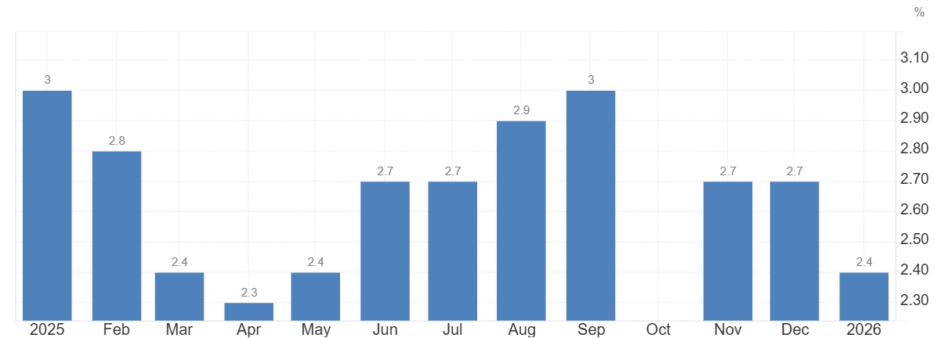
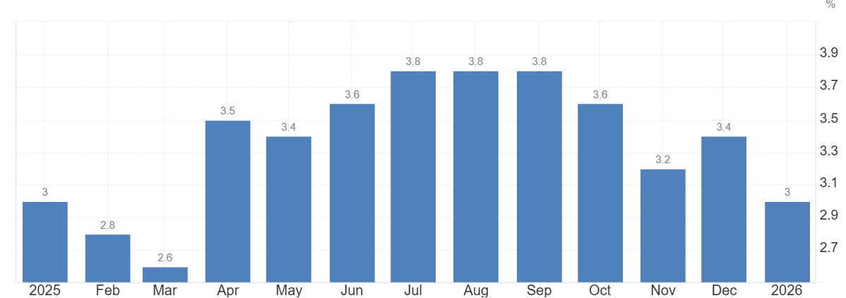
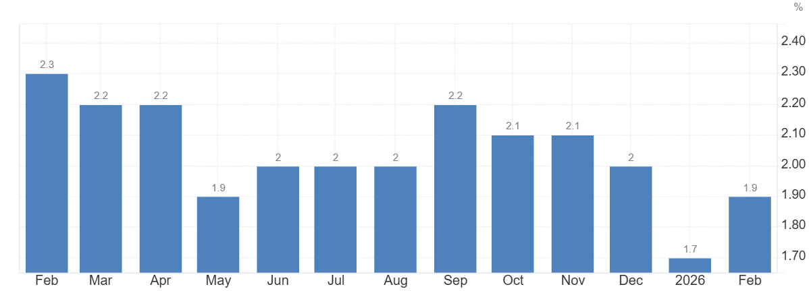
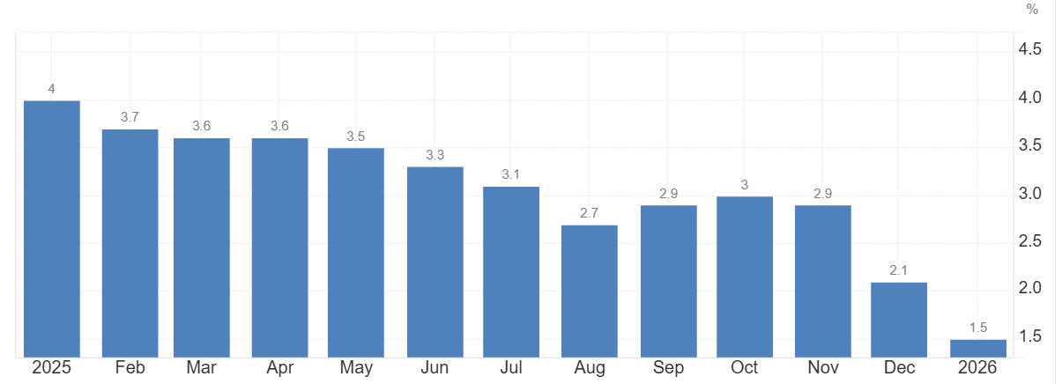
Global inflation trends remain mixed
U.S
UK
EU
Japan
Source: Trading Economics
www.shriramamc.in

Slide 18

Domestic Update
www.shriramamc.in

Slide 19
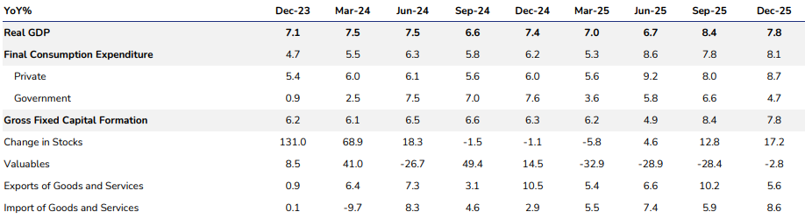
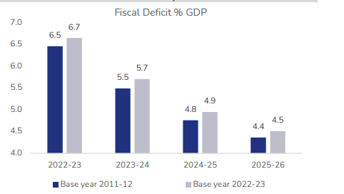
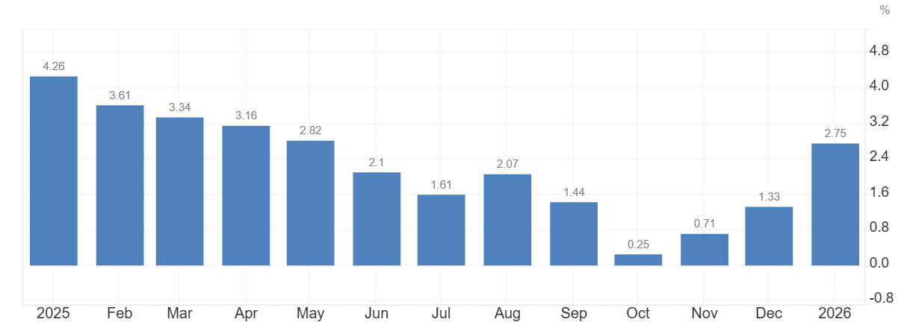
Macro Updates
India’ GDP growth rate
India’s inflation rises in Jan-26
Private consumption drove growth, net exports dragged in Q3FY26
Base year revised from 2011-2012 to 2022-2023
Source: Gst.gov.in
www.shriramamc.in

Slide 20
GST collections remain resilient
GST collections up 8.1% YoY to ~Rs 1.83L cr in Feb-26, led by steady domestic consumption
Source: Gst.gov.in
www.shriramamc.in

Slide 21
PMI : Manufacturing Strengthens
India’s Manufacturing PMI rose to 56.9 in Feb-26, driven by robust domestic demand
India’s Services PMI remained steady at 58.1 in Feb-26, amid slower growth in new orders
Source: Trading Economics
Data as on Feb-26
www.shriramamc.in

Slide 22
Outlook – Medium Term
Inflation
India’s CPI rose to 2.75% (Jan-26), driven by firm core inflation
Liquidity
RBI advancing its Rs 1 lakh crore OMO purchases to stabilize the market liquidity
Interest rate
RBI keeps interest rate unchanged at 5.25%, continues neutral stance
Bond Markets
Equity Markets
India’s 10Y G-sec flat at ~6.6% in Feb-26, as investors balanced strong demand with heavy supply
Domestic equities may remain range-bound amid elevated valuations and rising geopolitical tensions in the Middle East
Fed left interest rate unchanged in Jan-26, in line with expectations
US 10Y note yield softened at 3.96% in Feb-26, amid evolving inflation and interest rate expectations
Global markets remain volatile amid rising Middle East and global trade uncertainty
US headline CPI eased to 2.4% (Jan-26), led by cooling energy and goods prices
Liquidity to remain sufficient amid rupee volatility
Source: Trading Economics, Investing.com, Money control, Federal reserve
www.shriramamc.in

Slide 23
Key Risks
Escalating Middle East tensions risk pushing crude oil prices higher, widening India's current account deficit and fueling inflation
FII flow volatility, as global investors shift allocations based on US yields and risk sentiment
Mid & small cap valuations remain stretched despite the recent correction
Global trade uncertainty rises as Donald Trump imposes 15% global tariffs under Section 122 despite the U.S. Supreme Court ruling restricting his tariff powers
www.shriramamc.in

Slide 24
Disclaimer
DISCLAIMER The views expressed herein are based on internal data, publicly available information and other sources believed to be reliable. Any calculations made are approximations, meant as guidelines only, which you must confirm before relying on them. This document has been prepared based on information, which is already available in publicly accessible media or developed through analysis of Shriram Mutual Fund. The recipient should note and understand that the information provided above may not contain all the material aspects relevant for making an investment decision and the security may or may not continue to form part of the scheme's portfolio in the future. Investors are advised to consult their investment advisor before making any investment decision in light of their risk appetite, investment goals, and horizon. The decision of the Investment Manager may not always be profitable; as such decisions are based on the prevailing market conditions and the understanding of the Investment Manager. Actual market movements may vary from the anticipated trends. Past performance may or may not be sustained in future. Sectors referred above are illustrative and not recommended by Shriram Mutual Fund (the Fund) / Shriram AMC. The Fund may or may not have any present or future positions in these sectors. Shriram AMC / the Fund is not guaranteeing / offering / communicating any indicative yield on investments made in the scheme(s). Neither Shriram AMC and the Fund nor any person connected with them, accepts any liability arising from the use of this document. The recipient(s) before acting on any information herein should make his/her/their own investigation and seek appropriate professional advice and shall alone be fully responsible / liable for any decision taken on the basis of information contained herein. Please refer to the Offer Documents/ Statement of Additional Information/ Key Information Memorandum of the Scheme before investing.
MUTUAL FUND INVESTMENTS ARE SUBJECT TO MARKET RISKS, READ ALL SCHEME RELATED DOCUMENTS CAREFULLY.
www.shriramamc.in

Slide 25
Thank You

